Slide 1

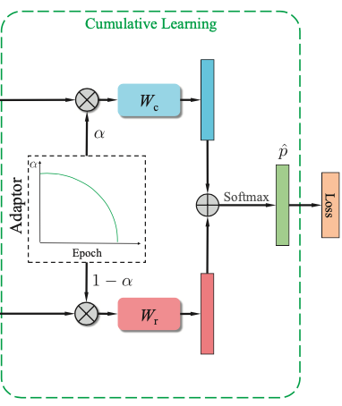
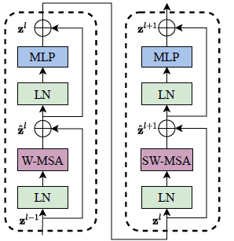
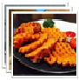
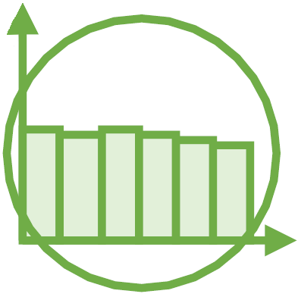
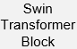
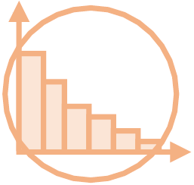
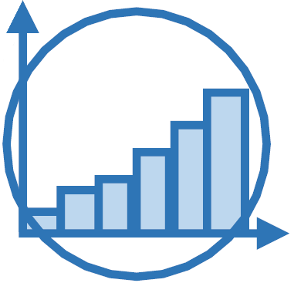
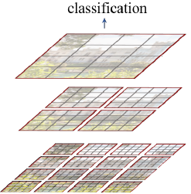
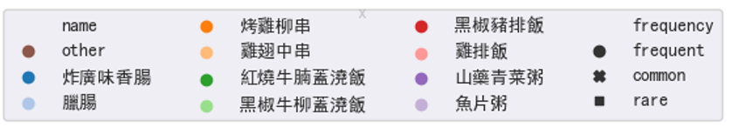
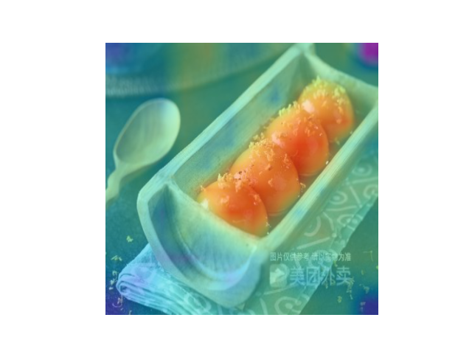
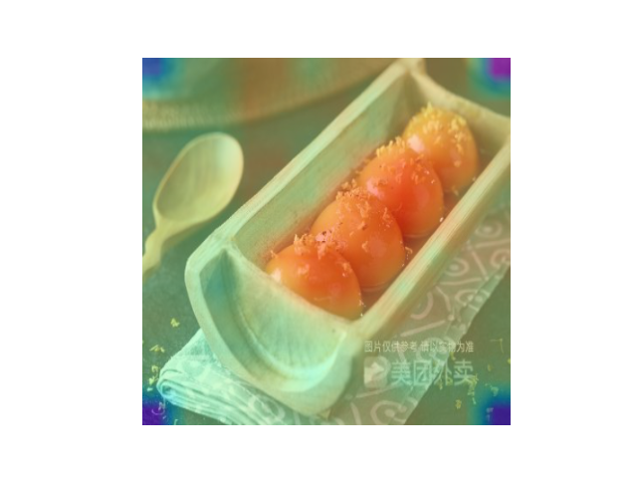
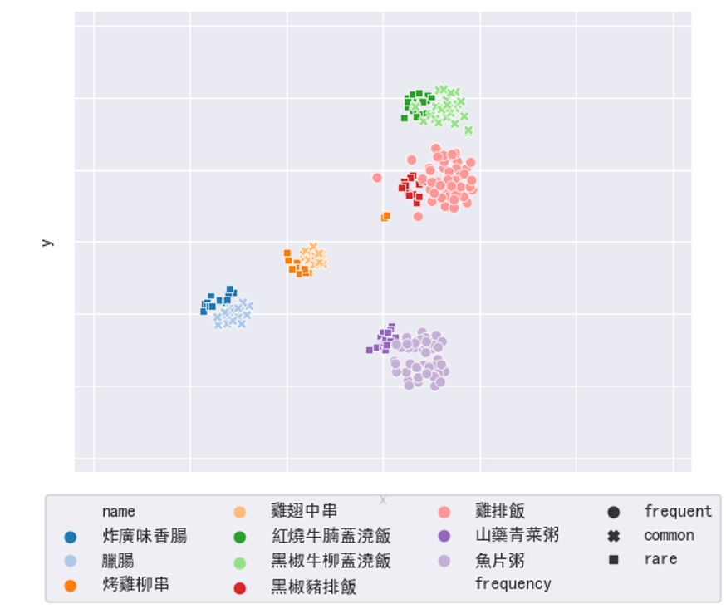
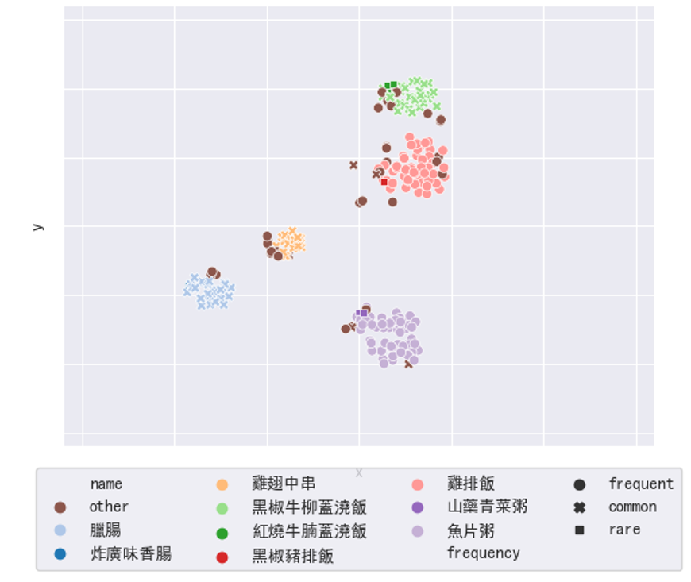
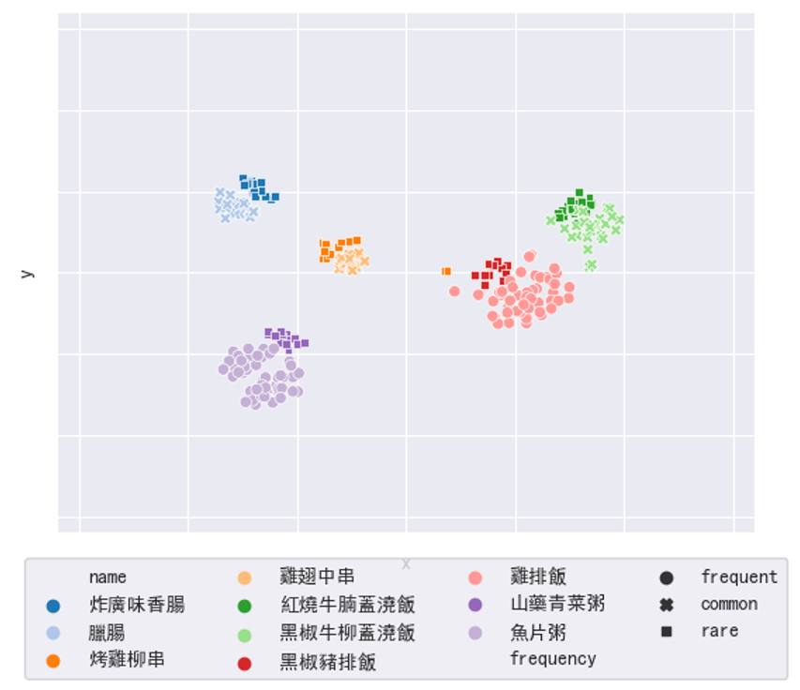
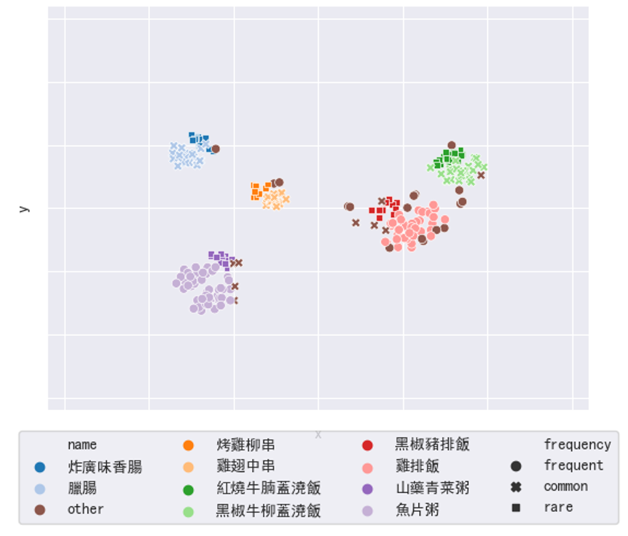
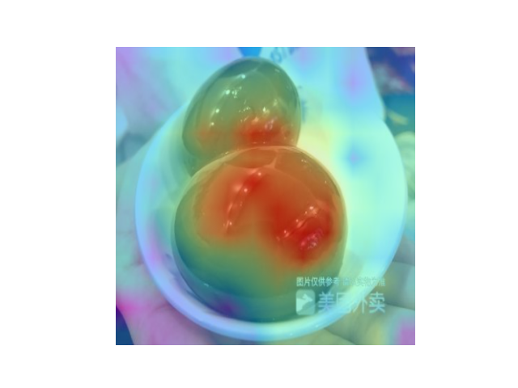
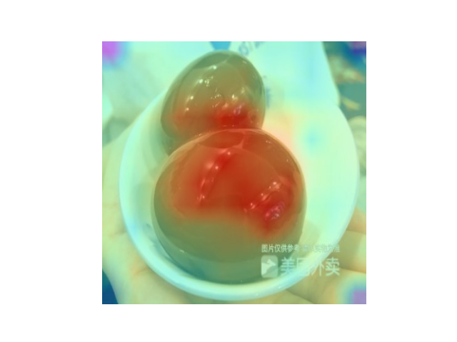
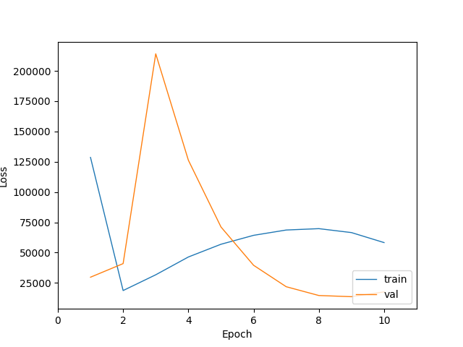
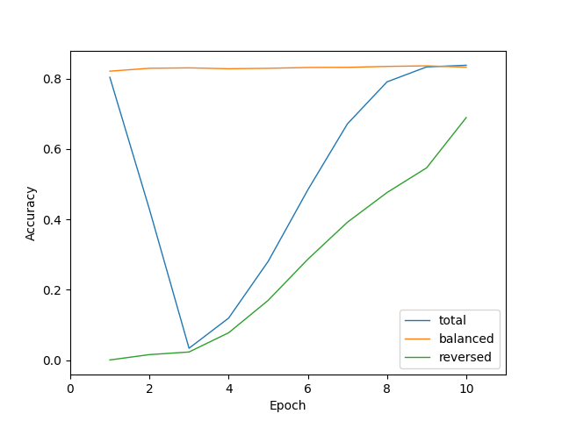
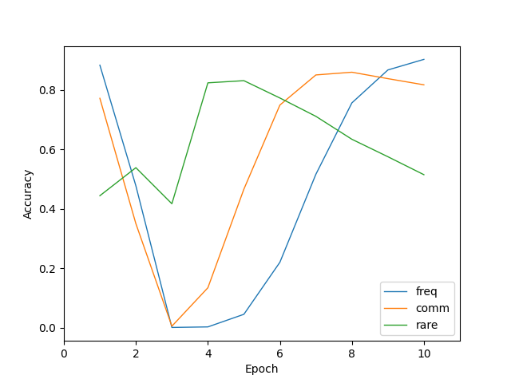
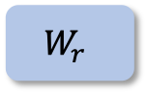
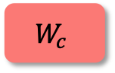
Yi-Hsien Lin D06943006
Hung-Yu Shu R09943021
Cheng-You Tsai R10943014
Chih-Ying Liu B07901039
Pin-Hua Lee B07303024
Long Tail Annihilator
NTU DLCV Fall 2021
Long Tail Annihilator
Model Architecture
Bilateral-Branch Network
Weight-shared SWIN Transformer
Swin Transformer Concept
Training Branch 1
Cumulative Learning
Partial Partition
$$W_{c}$$
Linear Embedding
Patch Merging
Patch Merging
Patch Merging
Balanced Sampler
x2
x2
x6
x2
Training Branch 2
Two Successive
Swin Transformer Blocks
Partial Partition
Classification
Uniform Sampler
Linear Embedding
Patch Merging
Patch Merging
Patch Merging
$$W_{r}$$
Reversed Sampler
x2
x2
x6
x2
Decoupling
Train Stage 1
Train Stage 2 Choices
Balanced Sampler
(Train on Feature Extractor)
Balanced Sampler
(Train on Classifier)
Balanced Sampler
(Train on Both)
Hierarchical Feature Maps
Uniform Sampler
Reversed Sampler
(Train on Feature Extractor)
Reversed Sampler
(Train on Classifier)
Reversed Sampler
(Train on Both)
Visualization
TSNE (Decouple)
Baseline
Reversed Sampler
Ground Truth
Predict Swin baseline
Ground Truth
Predict Swin w/ reverse sampler
Loss
Branch Validation Accuracy
Track Validation Accuracy
Attention Map (Decouple)
Experiments
Loss and Accuracy (Bilateral-Branch Network)
Classifier
Decoupling
Backbone | Main | Frequent | Common | Rare
ResNest269 | 67.53% | 86.68% | 64.52% | 20.46%
EfficientNet-B7 | 64.99% | 82.65% | 63.03% | 21.79%
ViT | 60.56% | 83.61% | 56.38% | 8.34%
Swin Transformer | 73.76% | 90.68% | 72.93% | 31.20%
Method | Sampler | Main | Frequent | Common | Rare
Stage 1 Training | B
 | U
Stage 2 Trained on Feature | B
 | R
Stage 2 Trained on MLP | B
 | R
Stage 2 Trained on Both | B
 | R
Bilateral-Branch Network
Backbone | Sampler | Main | Frequent | Common | Rare
Uniform | U
 | B
Balanced | U
B: Balanced sampler / U: Uniform sampler / R: Reversed sampler

